Slide 1

INSTITUTE OF ENGINEERING AND TECHNOLOGY
DR. RAMMANOHAR LOHIA AVADH UNIVERSITY, AYODHYA
PRESENTATION
ON
GRID FAILURE PROTECTION SYSTEM
PRESENTED BY :
Bheemsen Baharti (18722)
Abhinav Saurabh Mishra(18702)
Ajay Kumar (18704)
PROJECT SUPERVISOR :
Er. Vipin Patel
Asst. Prof. (EE Department)

Slide 2
Introduction
We know that in today’s time there is a big problem regarding failure of our grid(power distribution system) when a grid fails the electricity of the whole area get disconnected for days so it is a big problem to be solved that how to protect our grid before failure.
Keeping this point in our mind we are trying to develop a system which can turn our grid of when dangerous condition occurs.
Sensing these two conditions we regulate all our decisions suppose if the transformer temperature is less than a particular level then a indication is provided and even if temperature exceeds a particular level then also a indication is provided if the problem is not resolved then condition keeps on going down so the power supply from the grid disconnected and let the grid getting cooled when normal.
Temperature is attained then grid again starts functioning. And if grid voltage is increased above a particular level then that phase of grid will be cut off.
If phase voltage of grid is decreased below a particular level then that phase of grid will be cut off.
If phase voltage of grid limits then that phase of grid will be on.

Slide 3
Working Principle
The detecting power grid synchronization failure system on sensing frequency or voltage beyond the acceptable range is work on the principle of continuously sensing of voltage and frequency of supply sources.
In this the system, the microcontroller senses the supply voltage and frequency with help of operational amplifier, then these voltages and frequency are matched with the alternate supply voltages and frequency.
If the both are matched, then the microcontroller gives the logic high signal to relay driver IC then, this relay driver IC switch on the load relay, on which the lamp is directly connected. Similarly, if the both are not matched then the microcontroller turn off the output load through relay driver IC.
Here for the demonstration purposes, we can easily change the alternate source frequency and voltages and check the working of this system by turn on or off the lamp. This system is directly connected to wapda power supply and LDC display have been used here for seeing the supply voltages and frequency of both sources.

Slide 4
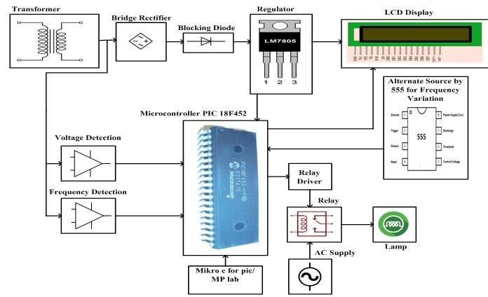
Project Block-Diagram

Slide 5
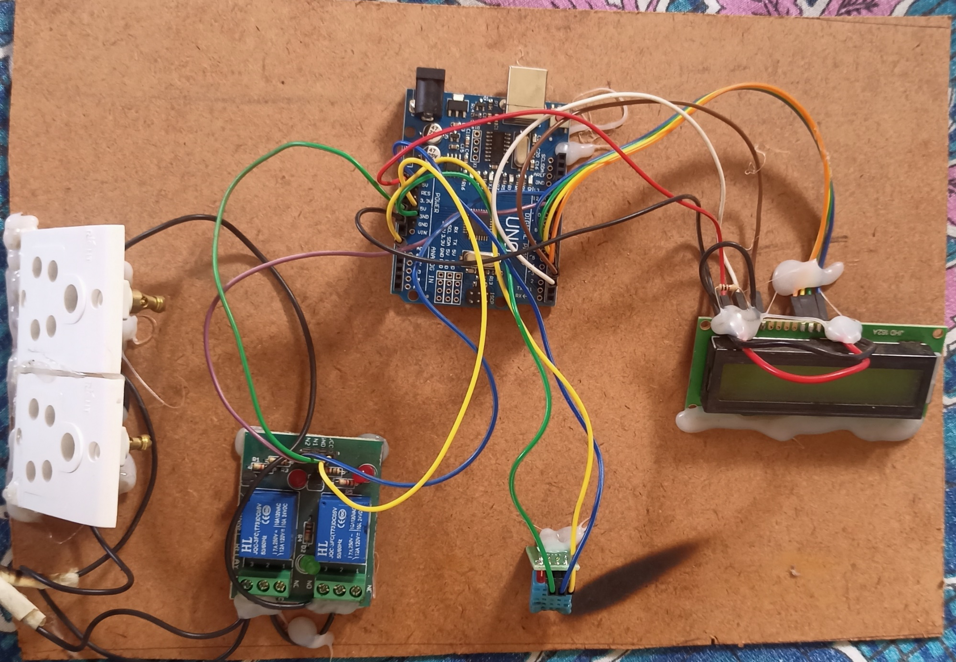

Slide 6
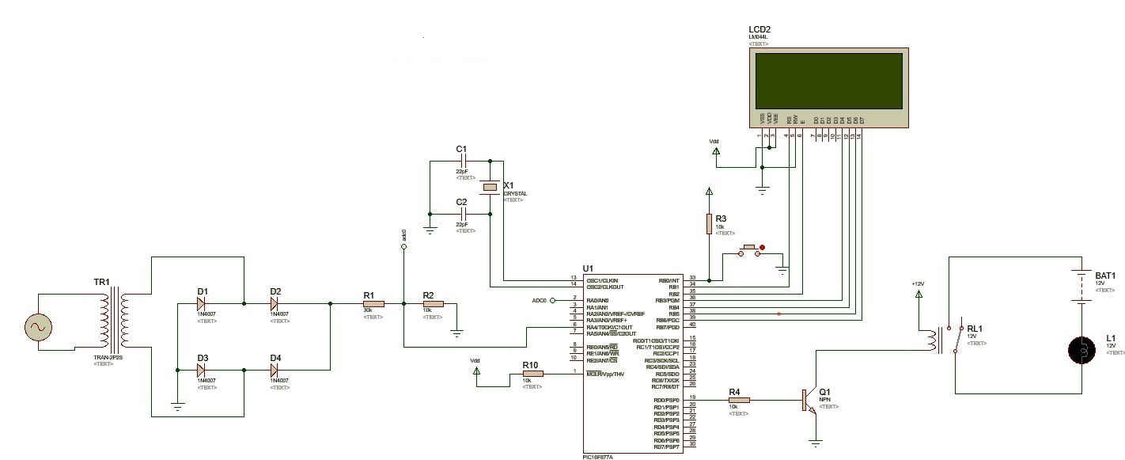
Circuit Model

Slide 7
Hardware Requirement
CH340 IC
AMS1117 IC
LM358 IC
ATMEGA328P CMOS 8-Bit Microcontroller
CY12.000 Crystal
JQC-3FC(T73) DC 5V RELAY
Carbon Film Resistor
BC547 Transistor
Aluminium Electrolytic Capacitor (47 25v VT)
Ceramic Capacitor
Surface mount Resistor
DHT 11 Digital Temperature &Humidity Sensor
JHD 162A LCD Display

Slide 8
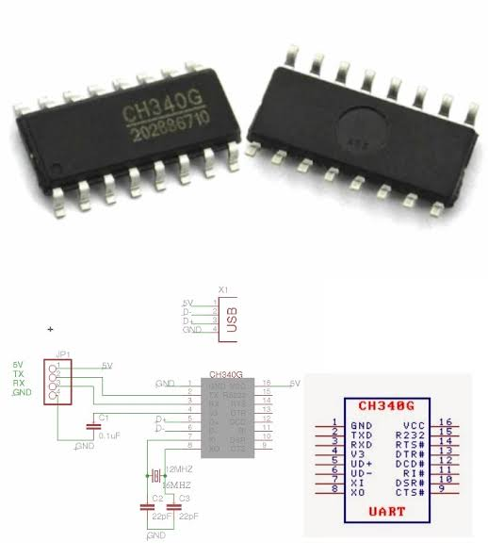
CH340 IC
CH340 is a USB bus converter chip which converts USB to serial port or printer port.
In UART mode, CH340 provides standard MODEM signals, used to extend serial port for computers, or upgrade directly from normal serial device to USB bus.
Supports 5V and 3.3V power supply voltages.
CH340C/N/K/E/X/B have integrated clock, no external crystal required, CH340B also integrates EEPROM used to configure the serial number, etc.

Slide 9
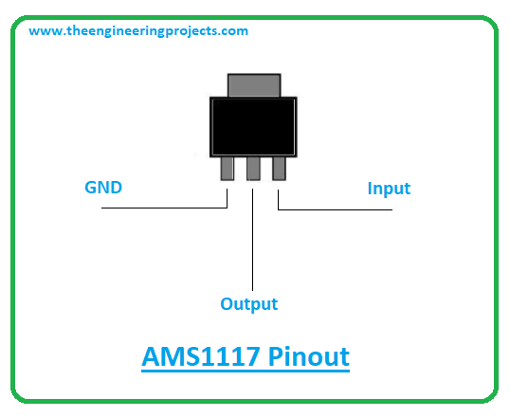
AMS1117 IC
The AMS1117 is a type of linear voltage regulator that is used in the circuit for varying the voltage flow from the input to the output of the circuit.
Dropout Voltage. Dropout voltage is the input-to-output differential voltage at which the circuit ceases to regulate against further reductions in input voltage; this point occurs when the input voltage approaches the output voltage.

Slide 10
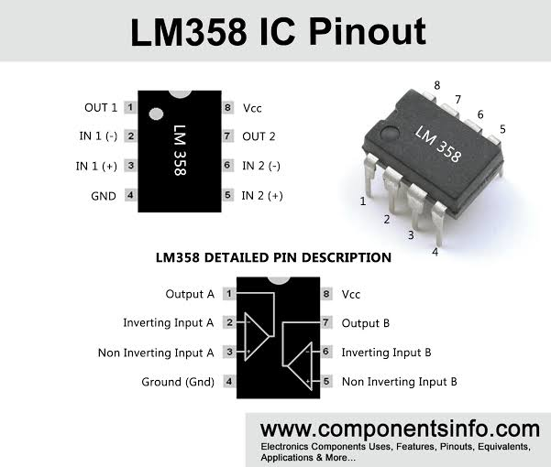
LM358 IC
This dark sensor IC LM358 circuit is used to test a light dependent resistor, a photo diode and a photo transistor. But, you need to change a photo diode and the photo transistor in place of LDR.
If you stop light falling on the light dependent resistor, then immediately the LM358 IC turns on the LED.
The main application of this circuit is in automobiles as an anti theft alarm.

Slide 11
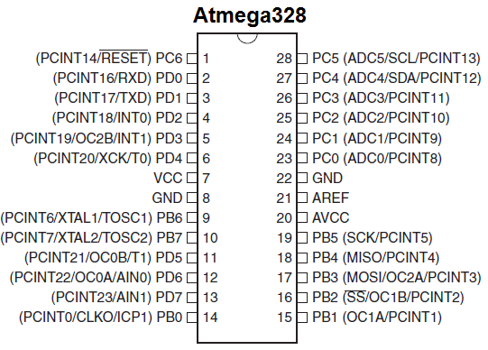
ATMEGA328P CMOS 8-Bit Microcontroller
ATmega328 is commonly used in many projects and autonomous systems where a simple, low-powered, low-cost micro-controller is needed.
The ATmega328 is a single-chip microcontroller created by Atmel in the mega AVR family (later Microchip Technology acquired Atmel in 2016).
It has a modified Harvard architecture 8-bit RISC processor core.

Slide 12
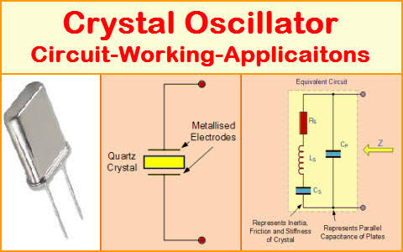
CY12.000 Crystal
This frequency is commonly used to keep track of time, as in to provide a stable clock signal for integrated circuits, and to stabilize frequencies for radio transmitters and receivers.
This frequency is commonly used to keep track of time, as in to provide a stable clock signal for integrated circuits, and to stabilize frequencies for radio transmitters and receivers.
The most common type of piezoelectric resonator is the quartz crystal, so oscillator circuits incorporating them became known as crystal oscillators, but other piezoelectric materials including polycrystalline ceramics are used in similar circuits.

Slide 13
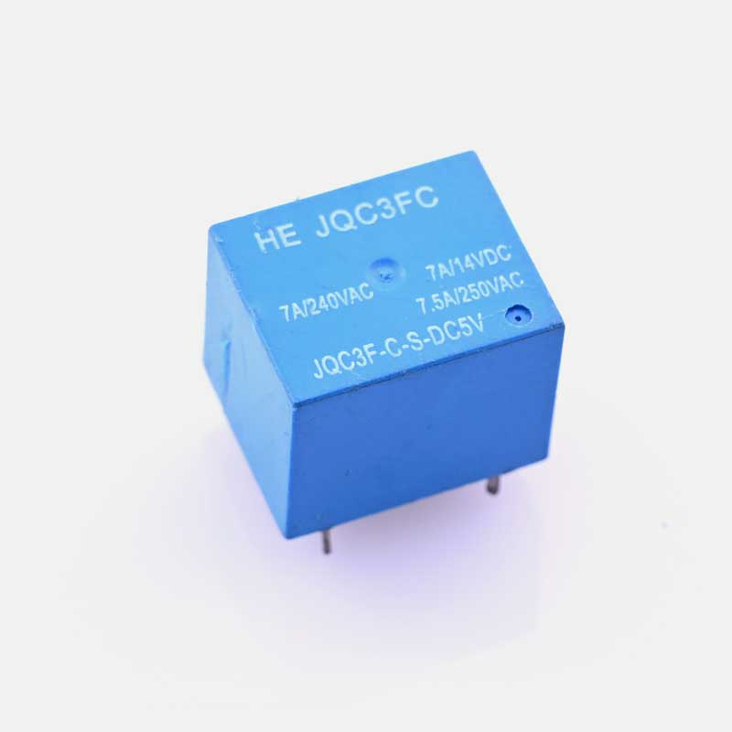
JQC-3FC(T73) DC 5V RELAY
A 5v relay is an automatic switch that is commonly used in an automatic control circuit and to control a high-current using a low-current signal. The input voltage of the relay signal ranges from 0 to 5V.
The components in a 5v relay module with a single channel include a relay, output terminal, status LED, power LED, freewheeling diode, input connector & switching transistor.
Relay is one kind of electro-mechanical component that functions as a switch. The relay coil is energized by DC so that contact switches can be opened or closed. A single channel 5V relay module generally includes a coil.

Slide 14
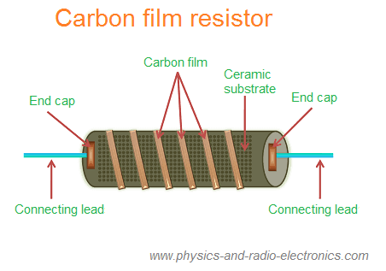
Carbon Film Resistor
The typical uses for carbon film resistors are in high voltage and high temperature applications.
Operating voltages up to 15 kV with a nominal temperature of 350 °C are feasible for carbon film resistors.. Example uses include high voltage power supplies, radars, x-rays, and lasers.
The carbon film resistor is a type of fixed resistor that uses carbon film to restrict the electric current to certain level.

Slide 15
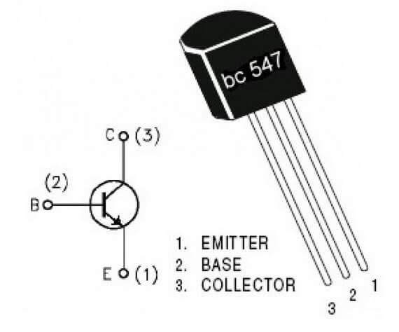
BC547 Transistor
BC547 is usually used for current amplifier, quick switching and pulse-width modulation (PWM).
Therefore, if you need to control the speed of a motor or actuator in some of your projects, you can simply use this transistor to achieve it.
The BC547 transistor is an NPN transistor.
A transistor is nothing but the transfer of resistance which is used for amplifying the current.

Slide 16
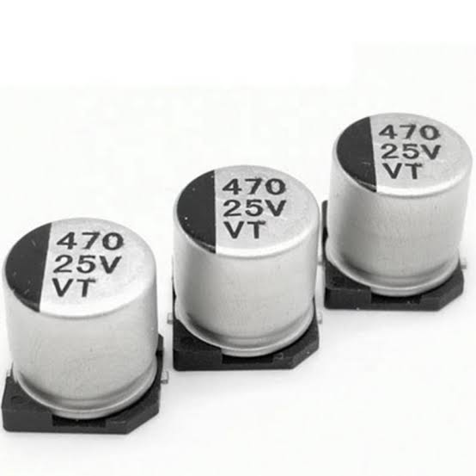
Aluminium Electrolytic Capacitor (47 25v VT)
Aluminum electrolytic capacitors are typically used in power supplies and DC-DC converters for smoothing and buffering rectified DC voltages in many electronic devices.
They are also used in industrial power supplies.
Aluminum electrolytic capacitors are polarized capacitors because of their anodization principle.

Slide 17
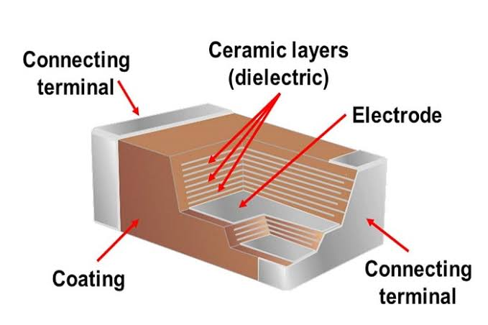
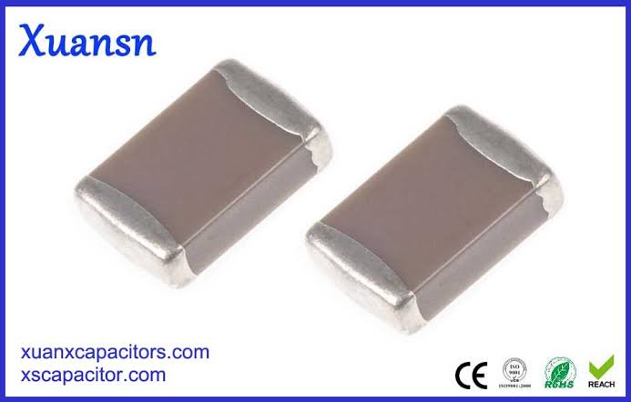
Ceramic Capacitor
Ceramic capacitors are mainly used for high stability performances and low-loss devices. These devices provide very accurate results, and also, the capacitance values of these capacitors are stable with respect to the applied voltage, frequency and temperature.
Ceramic disc capacitors are made by coating a ceramic disc with silver contacts on both sides as shown above illustrates.
Ceramic disc capacitors have a capacitance value of about10pF to 100μF with a wide variety of voltage ratings, between 16V to 15 KV and more.

Slide 18
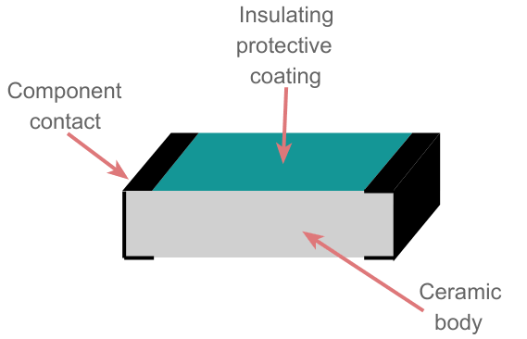
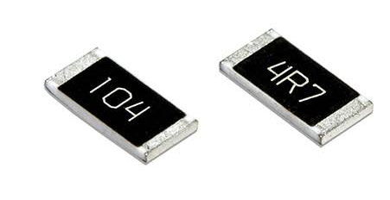
Surface mount Resistor
Surface mount resistors are commonly used in telecommunication, automotive, and medical equipment, as well as in personal devices, displays, and advanced technology research instruments.
This component uses surface mount technology.
The main benefits of using this technology are, high signal transmission speed, effects of high frequency are good, SMT is helpful in automatic production, efficiency improving and material cost is less.

Slide 19
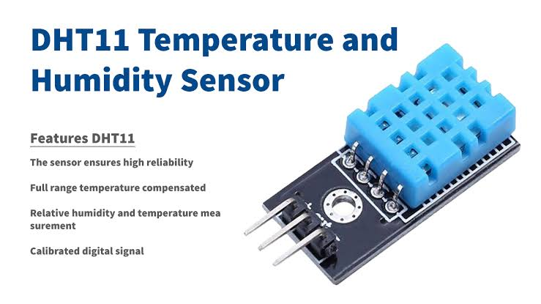
DHT 11 Digital Temperature &Humidity Sensor
The DHT11 is a basic, ultra low-cost digital temperature and humidity sensor.
It uses a capacitive humidity sensor and a thermistor to measure the surrounding air, and spits out a digital signal on the data pin (no analog input pins needed).
The best sensor for small-scale projects, which involves both Temperature & Humidity values.

Slide 20
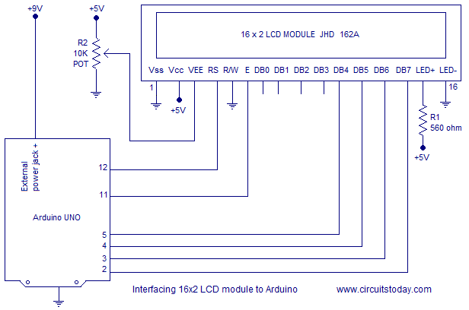
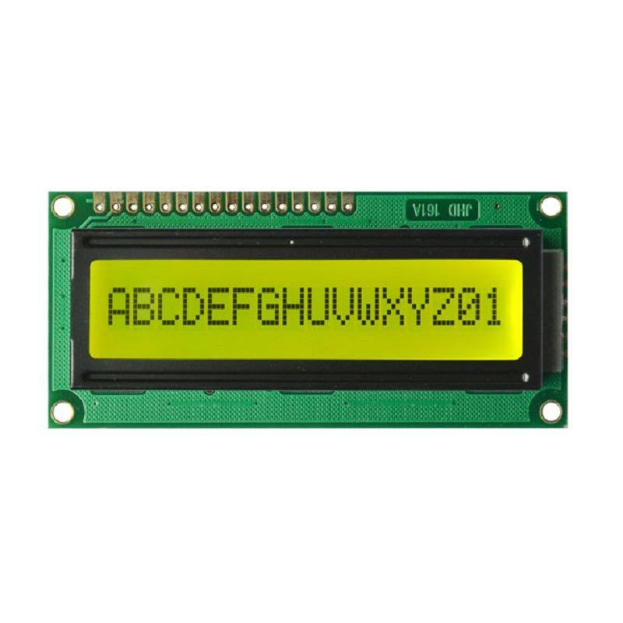
JHD 162A LCD Display
Commonly Used in Student Project, College, copiers, fax machines, laser printers, industrial test equipment, networking equipment such as routers and storage devices.
LCD display module with Green/Yellow Backlight. SIZE: 16×2 (2 Rows and 16 Characters per Row).
Current consumption is 1mA without backlight.

Slide 21
Conclusion
The project was completed successfully with in the given time duration. it was learning experience through which we gained invaluable on hand practical knowledge with project enlightened us on the vastness and unique application of micro controller , which forms the basic framework of our project.
This project gave us the deep understanding of the controller and described us how to use the controller in different ways.
This is embedded based project as embedded is the combination of both the software as well as the hardware so this system helped us to clear all our doubts related to basic electronic components.

Slide 22


